Slide 1
Slide 1: Title Slide
Title: Predicting Customer Churn for Syria Tel
Subtitle: A Data-Driven Approach to Improving Customer Retention
Presented by: Noordin Hassan Bare
Date: 23/2/2025

Slide 2
Slide 2: Overview
What is Churn? Customers who leave the service.
Why Does It Matter? Customer retention is crucial for revenue.
Objective: Use data to predict which customers are at risk of leaving.

Slide 3
Slide 3: Business and Data Understanding
Business Problem: Syria Tel wants to reduce customer churn.
Data Used: Customer usage patterns, billing, and service calls.
Approach: Analyze historical data to identify churn indicators.

Slide 4
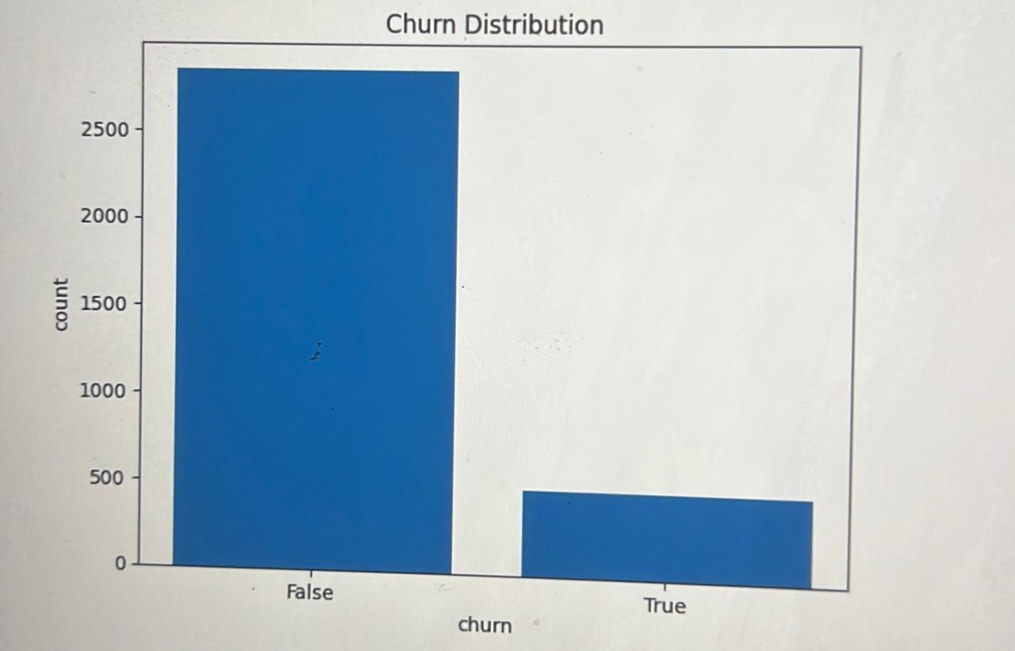
Slide 4: What is Classification?
Definition: A machine learning technique that categorizes data.
Why It Matters: Helps predict whether a customer will churn (Yes/No).
Real-World Example: Banks predicting loan defaults.
For our case the churn is shown in the diagram

Slide 5
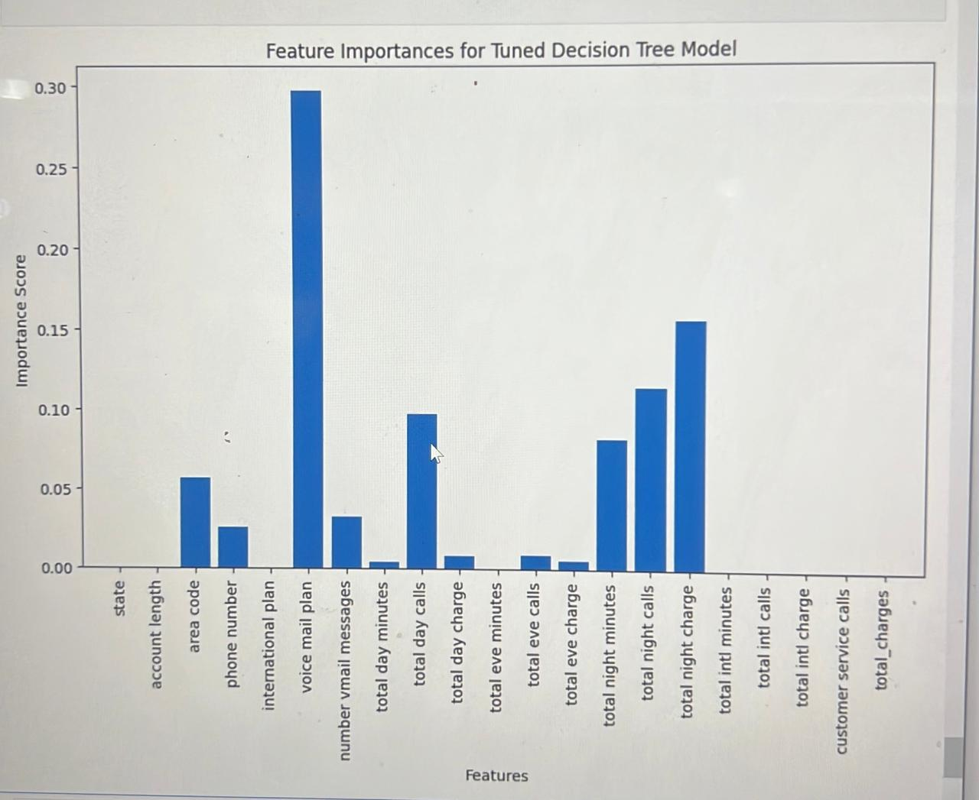

Slide 5: Key Factors in Churn Prediction
Most Important Features:
Customer Service Calls: High calls often indicate frustration.
Monthly Charges: Higher bills may lead to dissatisfaction.
Contract Type: Short-term customers churn more often.

Slide 6

Slide 6: Model Used & Evaluation
Models Tested:
Logistic Regression: Simple and interpretable.
Decision Tree: More flexible and powerful.
Tuned Decision Tree: Improved accuracy by adjusting parameters.
Performance Metrics:
Accuracy: How often the model was correct.
Precision & Recall: How well the model identified actual churners.

Slide 7
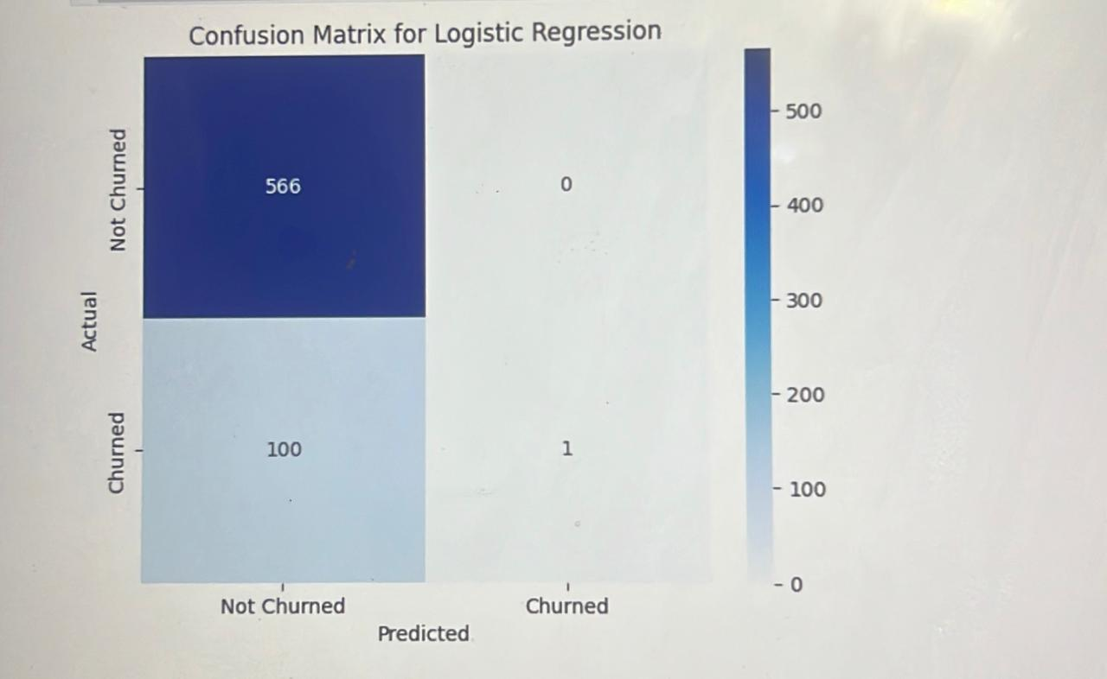
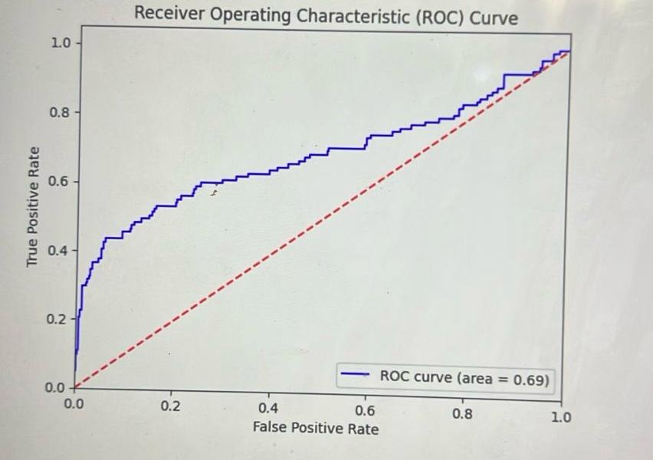
Logistic regresion

Slide 8
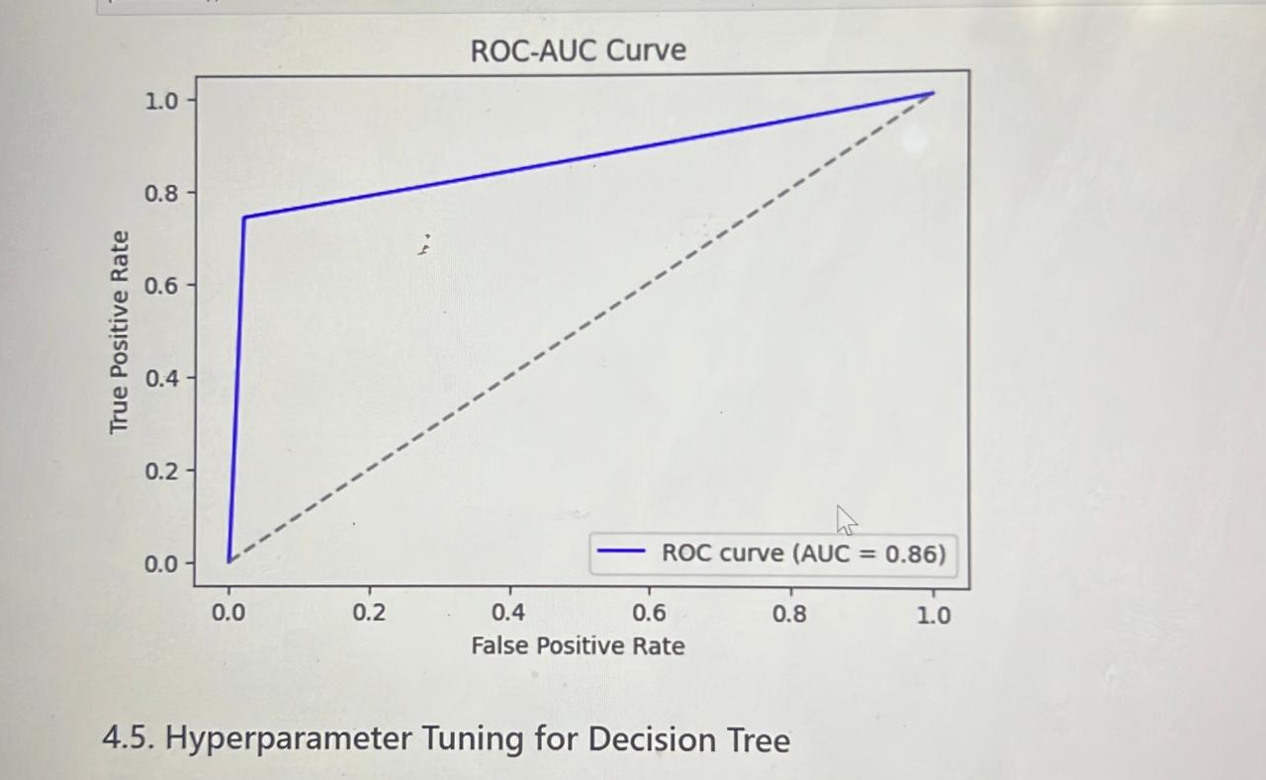
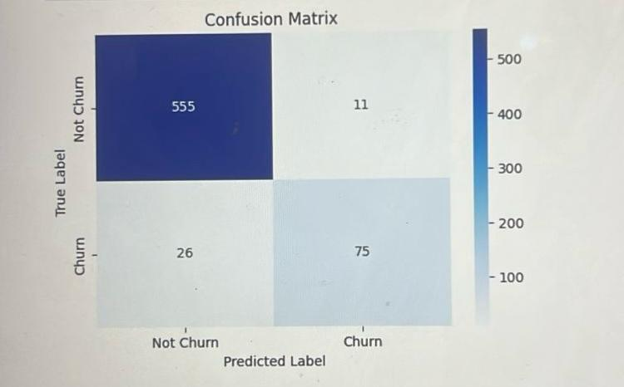
Decision tree model

Slide 9
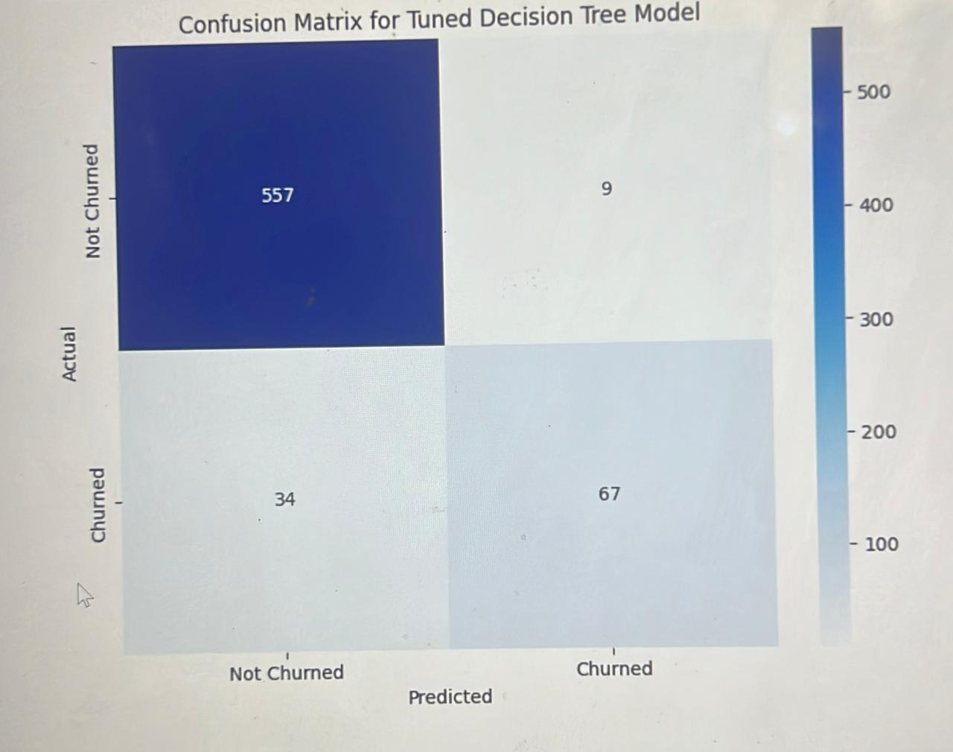
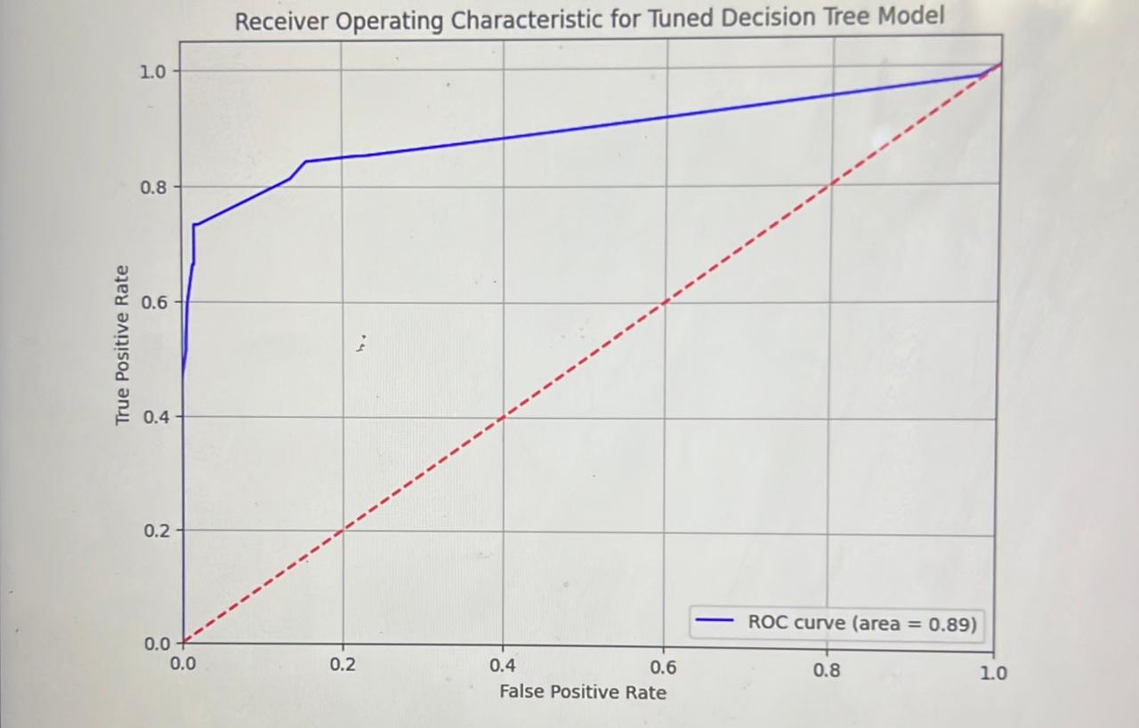
Tuned decision tree model

Slide 10
Slide 7: Key Findings
Churn Rate: 6%
Top Predictors: Customer service calls, monthly charges, contract type.
Model Accuracy: Tuned Decision Tree performed best at 94%.

Slide 11
Slide 8: Business Recommendations
Reduce churn by:
Offering discounts to high-risk customers.
Improving customer service responsiveness.
Creating longer-term contract incentives.

Slide 12
Slide 9: Next Steps
Implement churn prevention strategies.
Monitor new customer churn trends.
Explore more advanced AI models for further improvements.

Slide 13
Slide 10: Thank You
Contact Information: noordino470@gmail.com
Questions? Open for discussion!

